Slide 1
Amazon EC2 & Its Benefits
Amazon Elastic Compute Cloud (Amazon EC2) is a web-based service that provides resizable computing capacity in the cloud - IaaS.
Amazon EC2 eliminates need to invest in hardware up front and enables the user to develop and deploy applications faster.
Amazon EC2 enables User to scale up or down the resources to handle changes in requirements or spikes in popularity.
Amazon EC2 provides a simple Web service interface

Slide 2
Amazon EC2 & Its Benefits
The web service interfaces can be used to launch as many or as few virtual servers as needed, configure security and networking, and manage storage.
AWS EC2 Reduces the time required to obtain and boot new server instances to minutes
Quickly scales capacity, both up and down, as your computing requirements change
Changes the economics of computing:
Pay only for capacity and resources that you actually use

Slide 3
Amazon EC2 & Its Benefits
EC2 allows users to rent virtual computers on which to run their own computer applications.
EC2 allows scalable deployment of applications by providing a Web service through which a user can boot an Amazon Machine Image to create a virtual machine, which Amazon calls an "instance", containing any software desired.
A user can create, launch, and terminate server instances as needed, paying by the hour for active servers, hence the term "elastic".
EC2 provides users with control over the geographical location of instances that allows for latency optimization and high levels of redundancy.
In November 2010, Amazon switched its own retail website to EC2 and AWS.

Slide 4
Amazon EC2 & Its Benefits
Amazon EC2 provides users with the ability to place one or more instances in multiple locations. Amazon EC2 locations are composed of Regions(such as North America and Europe) and Availability Zones.
Regions consist of one or more Availability Zones, are geographically dispersed, and are in separate geographic areas or countries.
Availability Zones are distinct locations that are engineered to be insulated from failures in other Availability Zones and provide inexpensive, low-latency network connectivity to other Availability Zones in the same Region.

Slide 5
Amazon Machine Image
A special type of virtual machine.
The main component of an AMI is a read-only file system image which includes an operating system (e.g. Linux or Windows) and any additional software required to deliver a service or a portion of it.
EC2 is based on Linux and Xen, and various OS images (Amazon Machine Images - AMIs) can be supported.
It is said that Amazon uses a heavily modified and adapted version of Xen.
EC2 is probably one of the biggest Xen installations deployed.

Slide 6
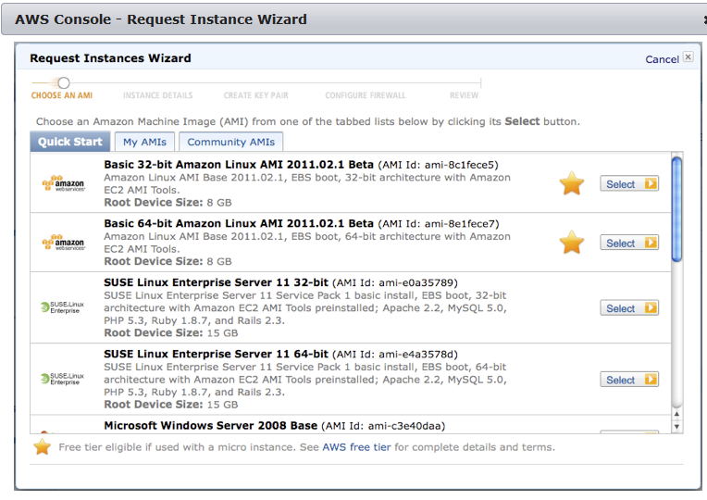
AMIs

Slide 7
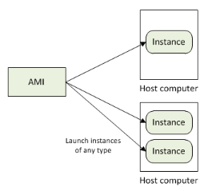
AMI and Instances
An Instance can be launched from an AMI.
An instance, is a copy of the AMI running as a virtual server in the cloud.
Multiple instances can be launched from a AMI, as shown in the figure.

Slide 8
AMI and instances
Amazon Machine Image (AMI):
Bootable, pre-defined or user-built
OS: Fedora, Centos, Gentoo, Debian, Ubuntu, Windows Server
Software packages: LAMP, mpiBLAST, Hadoop
Instance:
Running copy of an AMI
Launch in less than 2 minutes
Start/stop programmatically
Amazon EC2 instances are the fundamental building block for computing needs in the AWS cloud.
Instances are created from an Amazon Machine Image (AMI) and choosing an appropriate instance type.
An AMI is a template that contains a software configuration, including an operating system, which defines your operating environment.

Slide 9
Elastic Compute Units
The elastic compute unit (ECU) was introduced by Amazon EC2 as an abstraction of computer resources.
Amazon’s definition of ECU notes “We use several benchmarks and tests to manage the consistency and predictability of the performance of an EC2 Compute Unit.
One EC2 Compute Unit provides the equivalent CPU capacity of a 1.0-1.2 GHz 2007 Opteron or 2007 Xeon processor.
This is also the equivalent to an early-2006 1.7 GHz Xeon processor.”
Billing is done via ECUs used.

Slide 10
Amazon EC2 Instances and Types
Amazon EC2 offers several “hardware” instance types with different characteristics (cpu power, memory, disk and addressability) and different pricing.
Amazon EC2 instances are grouped into the general families described in the table.
Instance Family
General purpose
Compute optimized
Memory optimized
Storage optimized
Micro instances
GPU instances

Slide 11
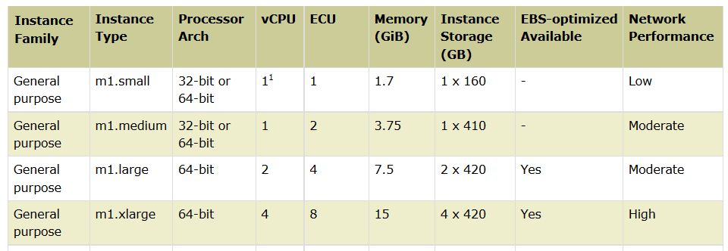
Instance Characteristics

Slide 12
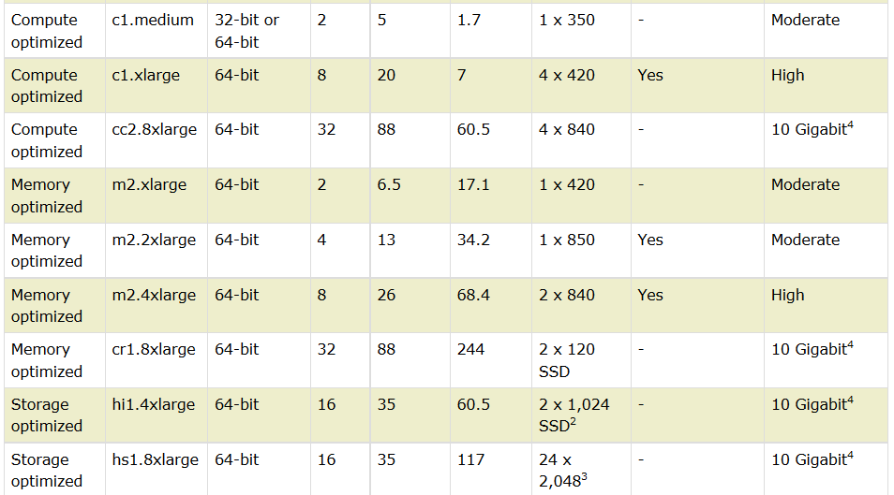
Instance Characteristics

Slide 13
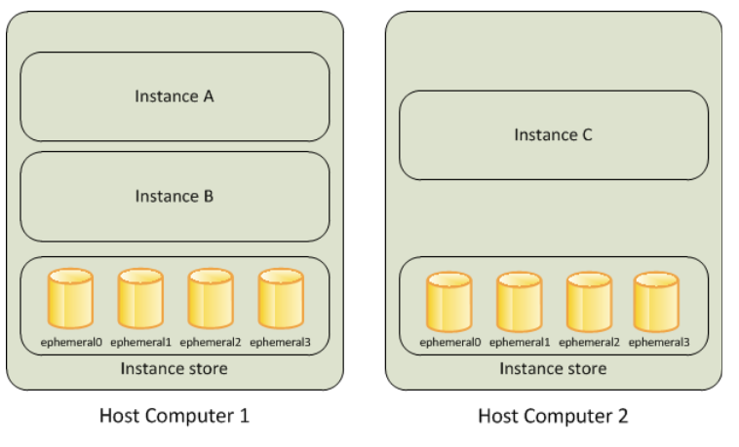
Amazon EC2 Instance Store

Slide 14
Instance Store and S3
Amazon EC2 Instance Store
Amazon EC2 instance store provides temporary (aka ephemeral) block-level storage for use with Amazon EC2 instances. The size of an instance store ranges from 150 GB up to 48 TB, and varies by instance type. Larger instance types have larger instance stores.
Amazon Simple Storage Service (Amazon S3)
Provides traditional persistent file storage. Used for storing AMIs, data, etc.
Actually designed as storage for the internet. You can use Amazon S3 to store and retrieve any amount of data at any time, from anywhere on the web.

Slide 15
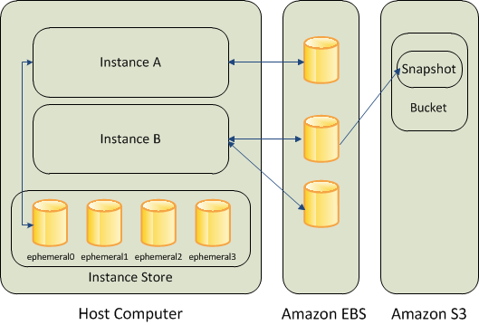
Relationship between different storage

Slide 16
Amazon Elastic Block Store
Amazon Elastic Block Store (EBS) provides block level storage volumes for use with Amazon EC2 instances. Amazon EBS volumes are network-attached, and persist independently from the life of an instance.
Amazon EBS provides highly available, highly reliable, predictable storage volumes that can be attached to a running Amazon EC2 instance and exposed as a device within the instance.
Amazon EBS is particularly suited for applications that require a database, file system, or access to raw block level storage.

Slide 17
Amazon Elastic Block Store
Storage designed specifically for Amazon EC2 instances.
Allows to create volumes that can be mounted as devices by EC2 instances.
Can have user supplied device names and provide a block device interface.
Possible to create a file system on top of Amazon EBS volumes, or use them in any other a block device could be used.
Possible to create up to twenty Amazon EBS volumes of any size (from one GB up to one TB).
Each Amazon EBS volume is independent of any individual EC2 instances and can be attached to any one of the instances (within the same availability zone) or can even exist unattached to an EC2 instance.

